Slide 1

Web scraping to gain company insights
19/11/2022

Slide 2
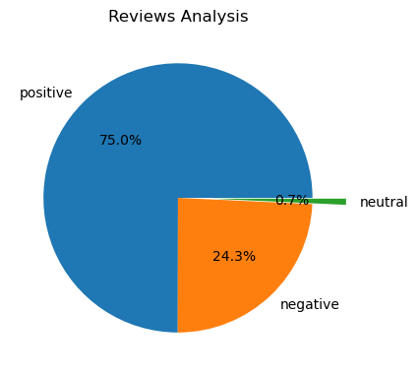
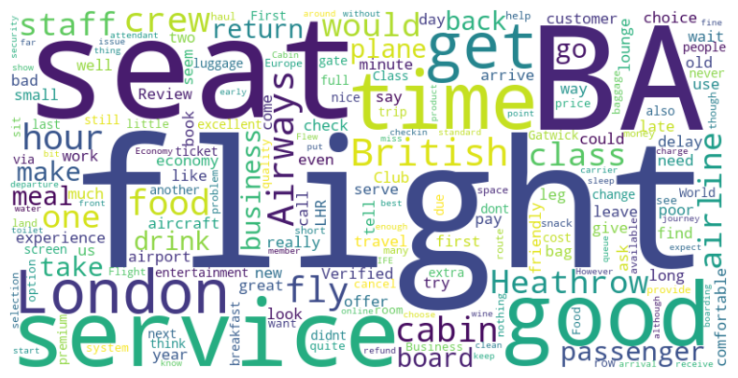
INSIGHTS FROM CUSTOMER REVIEWS
From cleaning 3688 reviews given by the customers, we obtained
Positive Reviews - 2765
Negative Reviews - 896
Neutral Reviews – 27
Word cloud of keywords used in reviews

